Slide 1

Coffee Shops of America

Slide 2
Coffee shops are a huge industry
There are over 35,000 coffee shops in the United States alone
Some coffee shops are made to quickly pick up a cup of coffee and others are made more for sitting down and enjoying a cup
Shops with quality coffee are recognized across various review boards
Yelp
Google Maps
FourSquare

Slide 3
Objectives
Analyze the distribution of both the quantity and quality of coffee shops across Atlanta
Compare average ratings of coffee shops in major cities across the country
Analyze ratings data of coffee shops with further use of statistics

Slide 4
Data and Library requirements
Data was obtained from Foursquare API
50 coffee shops in a 15 km radius from each city center
Geographical locations of each coffee shop
Average rating of each coffee shop on a 10-point scale
Number of ratings each coffee shop received
Notable Python Libraries Used
Pandas
Json Requests
Folium

Slide 5
Cities chosen for analysis
Atlanta
New York City
Seattle
San Francisco
Chicago
Washington D.C
Boston
Denver

Slide 6
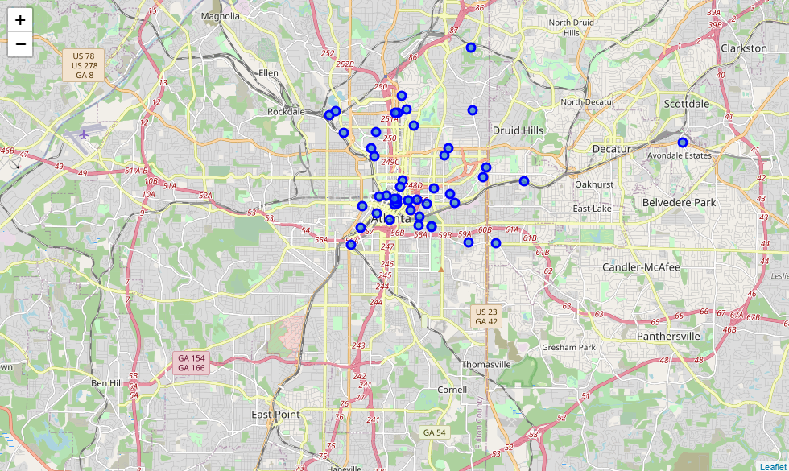
Distribution of coffee shops in atlanta

Slide 7
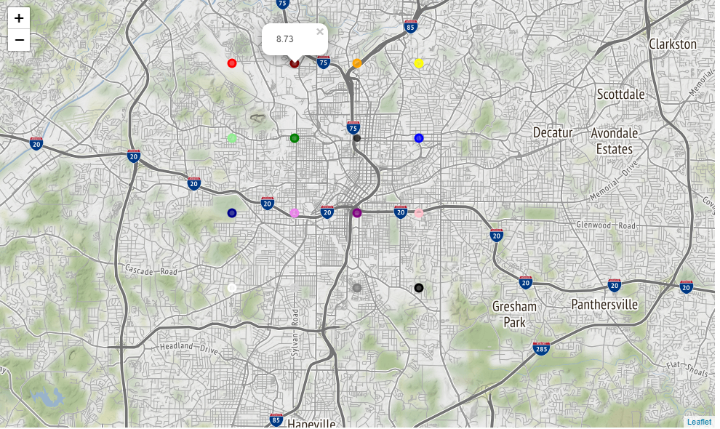
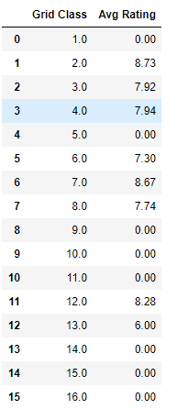
Ratings of coffee shops in different areas of Atlanta
More coffee shops were found in northern Atlanta
The highest rated areas were near midtown

Slide 8
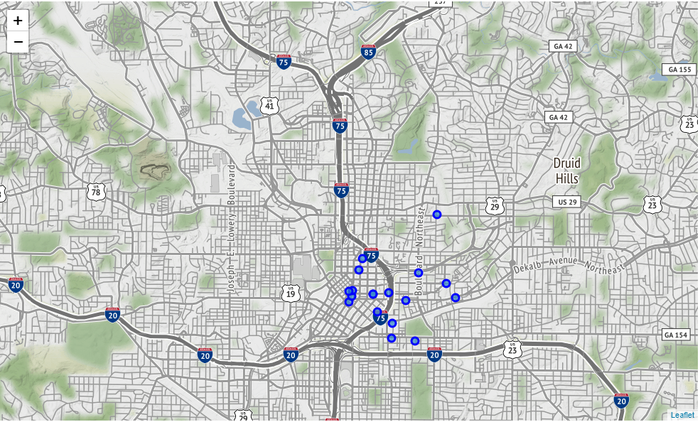
Best area in atlanta for coffee shops
Highest number of coffee shops out of any area in the city
Second highest average rating for coffee shops
“Dancing Goats Coffee”: Highest rated coffee shop in the area (9.1/10)

Slide 9
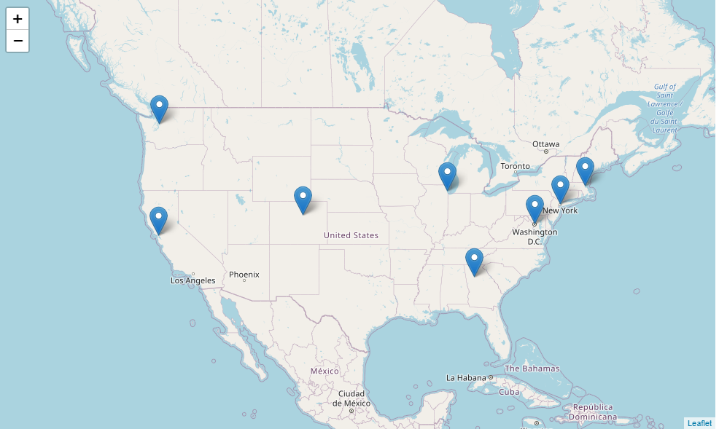
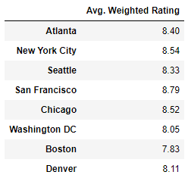
Comparison of coffee shops from different cities
Cities chosen for comparison
San Francisco had the highest average rating

Slide 10
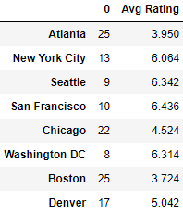
How ‘unknown’ coffee shops affect city ratings
Ratings when taking into account number of reviews
Number of “zero ratings’ and Ratings not taking into account number of reviews

Slide 11
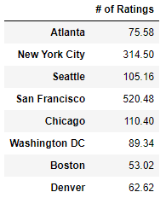
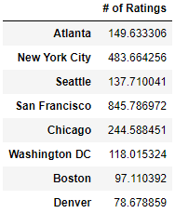
Number of ratings for each city
Average amount for each coffee shop
Standard deviation for each city

Slide 12
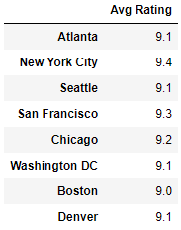
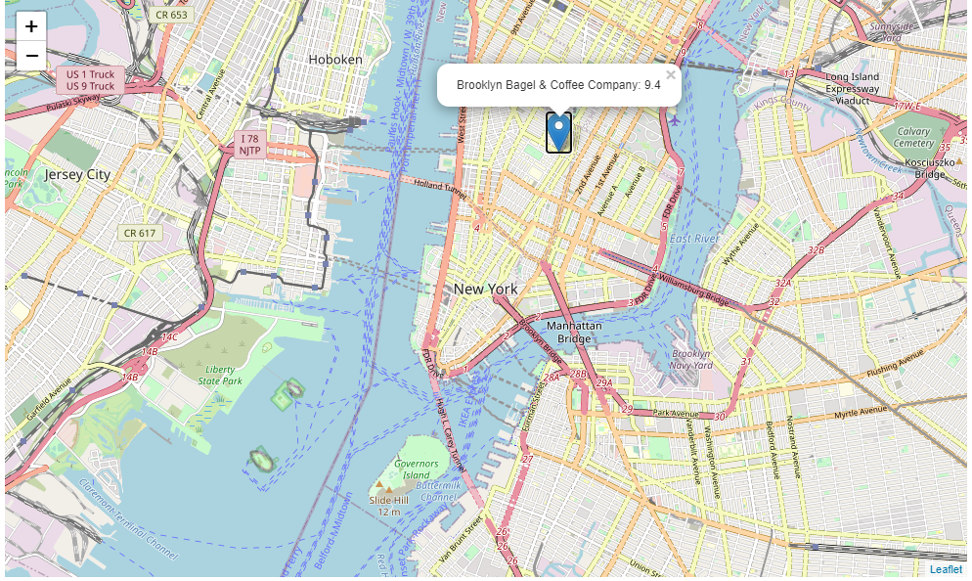
Highest rated coffee shop in each city

Slide 13
Conclusions and recommendations
Majority of coffee shops in Atlanta are in the center of the city
Highest rated coffee shop areas are around Midtown
San Francisco had the highest weighted average rating out of the cities chosen
Strong positive correlation between average rating and number of ratings in each city
Recommendations
Gather more coffee shops from each city over a wider radius
Incorporate demographic factors that could affect how cities rate their own coffee

